Slide 1

^{Chapter 1} Introducing Data Structures and Algorithms
Royal University of Phnom Penh
Faculty of Engineering
Data Structures and Algorithms
Dr. Srun Sovila

Slide 2
Outline
Arrays
Ordered Arrays
The Bubble Sort
The Insertion Sort

Slide 3
Outline
Arrays
Ordered Arrays
The Bubble Sort
The Insertion Sort

Slide 4
Linear Search
Linear Search is used with unordered array
Linear Search is checked value, we want to search with value of the 1st element, 2nd element, 3rd element, and so on
Thus, on the average it would check about ½ of number of array

Slide 5
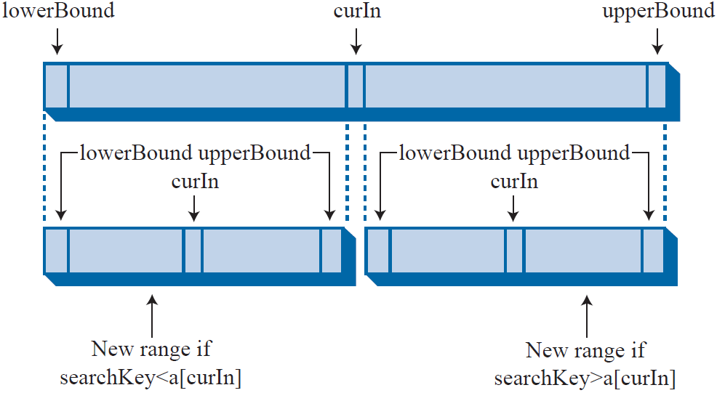
Ordered Arrays: Binary Search
int find(int searchKey){
int lowerBound = 0;
int upperBound = nElement-1;
int curIn;
while(true){
curIn = (lowerBound + upperBound ) / 2;
if(v[curIn]==searchKey){
return curIn; //found it
}
else if(lowerBound > upperBound)
return nElement; //can’t found it
else{ //divide range
if(v[curIn] < searchKey)
lowerBound = curIn + 1; //it’s in upper half
else upperBound = curIn - 1; //it’s in lower half
} //end else divide range } //end while
} //end find()

Slide 6
Ordered Arrays: Binary Search
The Guess-a-Number Game
A friend asks you to guess a number she’s thinking of between 1 and 100
When you guess a number (recommend middle number), she’ll tell you one of three things: your guess is larger or smaller than the number she’s thinking of
If she says it’s too high, you deduce the number is between 1 and 49, so your next guess should be 25.
Step Number | Number Guessed | Result | Rang of Possible Value
0 |  |  | 1 – 100
1 | 50 | Too High | 1 – 49
2 | 25 | Too Low | 26 – 49
3 | 37 | Too High | 26 – 36
4 | 31 | Too Low | 32 – 36
5 | 34 | Too High | 32 – 33
6 | 32 | Too Low | 33 – 33
7 | 33 | Correct

Slide 7
Ordered Array: Insertion
Insert an element to Ordered Array, first of all, find where (position) by value to put it
Insert element to the found position and move all bigger ones up (right)
Insert an element with value 21 into Array
Index | 0 | 1 | 2 | 3 | 4 | 5 | 6 | 7 | 8 | 9
Value | 12 | 15 | 23 | 26 | 43 | 57 | 83
Index | 0 | 1 | 2 | 3 | 4 | 5 | 6 | 7 | 8 | 9
Value | 12 | 15 | 21 | 23 | 26 | 43 | 57 | 83
23
26
43
57
83

Slide 8
Ordered Arrays: Deletion
Delete an element from array, first of all, find the deleted element in Ordered Arrays
In case, the deleted element found, move bigger ones down (left)
Delete an element with value 26 from Array
Using Binary Search to find element with value 26
Index | 0 | 1 | 2 | 3 | 4 | 5 | 6 | 7 | 8 | 9
Value | 12 | 15 | 23 | 26 | 43 | 57 | 83
Index | 0 | 1 | 2 | 3 | 4 | 5 | 6 | 7 | 8 | 9
Value | 12 | 15 | 23 | 43 | 57 | 83
43
57
83

Slide 9


Homework submit to: fe.assignment@gmail.com
Mon., 05-Oct.-2015
@ 15:00
Create an ordered array to store data any type, you want (such as: int, char, float,…);
Create a function to show elements of the ordered array;
Create a function to insert an element to the ordered array;
Create a function to delete an element (deleted value, which is input by user) from the ordered array;
Create a function of binary search in the ordered array by value, which is input by user.
Read book of Robert Lafore, page: 51 – 73 for next lecture

Slide 10
To be continued…

